Slide 1
Progress WDSP
Iftah Fahmi Waladi
4 SPE B
3210181052

Slide 2
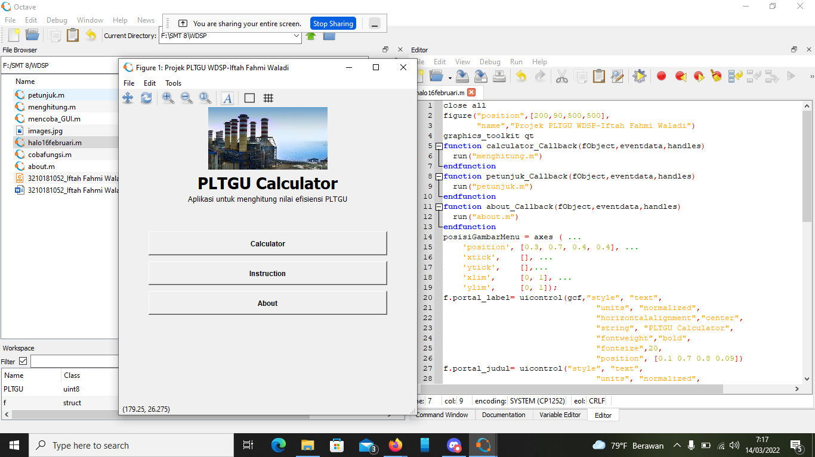
Tampilan Awal

Slide 3
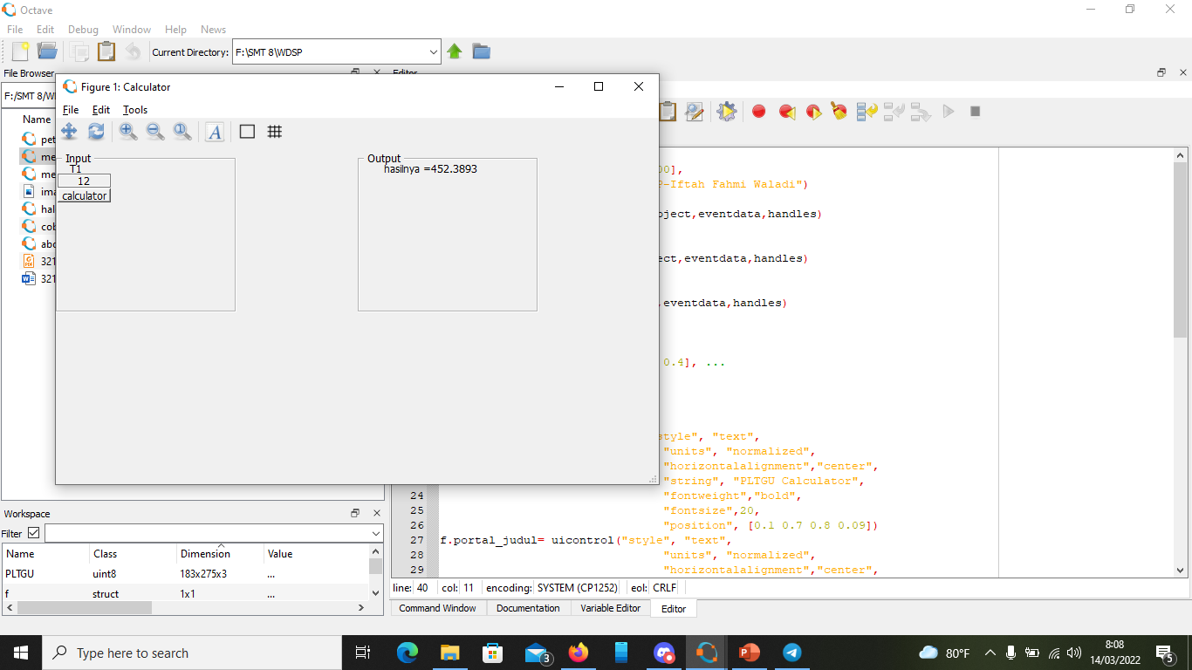
Menu Calculator

